Slide 1


Chronic Kidney Disease Dataset Challenge
Predicting Patients’ Chronic Kidney Disease Staging
MARC DE MELLO

Slide 2


AGENDA
Problem Statement
Current State of Data
Data Cleaning & Pre-Processing
Model Selection Criteria & Implementation
Model Result
Additional Insights and Future Improvements
Concluding Thoughts

Slide 3
PROBLEM STATEMENT
Create a solution to predict whether a patient will progress in Chronic Kidney Disease (CKD) staging, given the patient's past longitudinal information
Situation can be structured as a multivariate time series classification problem
Inputs are categorical and time series data
Output is boolean True/ False prediction for patient's CKD stage progression

Slide 4
CURRENT STATE OF DATA
3 tables with nominal categorical data
7 tables with unstructured time series data
Only 300 unique entries of patient data
True/ False CKD data is unevenly distributed (100 True, 200 False)
Time series data are unstructured, with no fixed time step
Stages table contains both categorical and time series data

Slide 5
DATA CLEANING & PRE-PROCESSING
Nominal categorical data (race, gender) are one-hot encoded
Primitive (average) of time series data are aggregated on id
Numerical features are standardized by removing the mean and scaling to unit variance
All data are then concatenated together longitudinally
Data split into 90% training data and 10% test data

Slide 6
MODEL SELECTION CRITERIA & IMPLEMENTATION
Given the low number of unique data entries, neural networks would not be ideal and time consuming to implement
Thus, classical machine learning algorithms were employed
Linear Regression
Support Vector Machines
Random Forest

Slide 7
MODEL RESULT
With Linear Regression as a baseline model, it managed a score of 0.7
Best performance was achieved by Random Forest with a score of 0.77
Some improvements were observed through data standardization, averaging about 0.05 basis points
Classification Report:
precision recall f1-score support
1 0.67 0.25 0.36 8
0 0.78 0.95 0.86 22
accuracy 0.77 30
macro avg 0.72 0.60 0.61 30
weighted avg 0.75 0.77 0.73 30

Slide 8
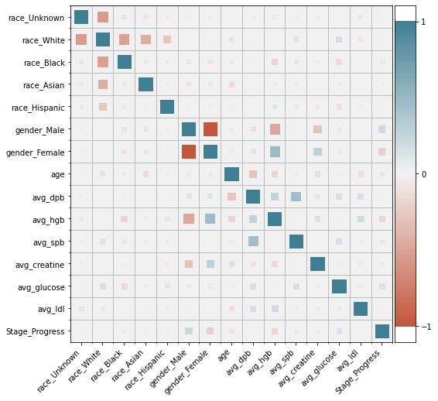
ADDITIONAL INSIGHTS & FUTURE IMPROVEMENT
Time series algorithms would have been ideal such as k-NN with Dynamic Time Warping or Shapelet-based
With one-hot encoding of categorical features, multicollinearity could present an issue, Variance Inflation factor could be used to address it
More time series data primitives could be added to potentially aid model performance
Time series data could potentially be concatenated and aggregated on patient id rather than broken down into primitives

Slide 9
CONCLUDING THOUGHTS
Random Forest algorithm proved to be the most effective
Time series algorithms would be ideal to explore given the amount of time series data
More time and effort should be dedicated to data pre-processing in order to allow the models to perform best

